Slide 2
FIT 152 Fundamentals of Information Technology
Lecture 11
Topic 5: Application domains

Slide 3
FIT 152: Module outcomes
Upon successful completion of this course, the student will be able to:
Demonstrate an understanding of the relationship between IT and related and informing disciplines.
Demonstrate insight in the history of computing technology, and an understanding of the Internet, and the World-Wide Web, as well as the components of an IT system and how they interrelate.
Demonstrate an understanding of complexity in an information technology environment and how and why it occurs.
Demonstrate an understanding of why life-long learning and continued professional development is critical for an IT professional.
Illustrate the use of information and communication technologies to solve problems.
Demonstrate an understanding of how and to what extent IT has changed various application domains.

Slide 4
Application Domains
Digital transformation
Digital transformation refers to the integration of digital technology into all aspects of an organisation's operations, fundamentally changing how it operates and delivers value to customers. It involves leveraging digital technologies to create new or modify existing business processes, culture, and customer experiences to meet changing business and market requirements.
Key Aspects:
It is not just about adopting new technologies but also about transforming business models, processes, and organisational culture.
It aims to improve efficiency, agility, innovation, and customer experiences.
It is an ongoing process that requires continuous adaptation to technological advancements and market dynamics.

Slide 5
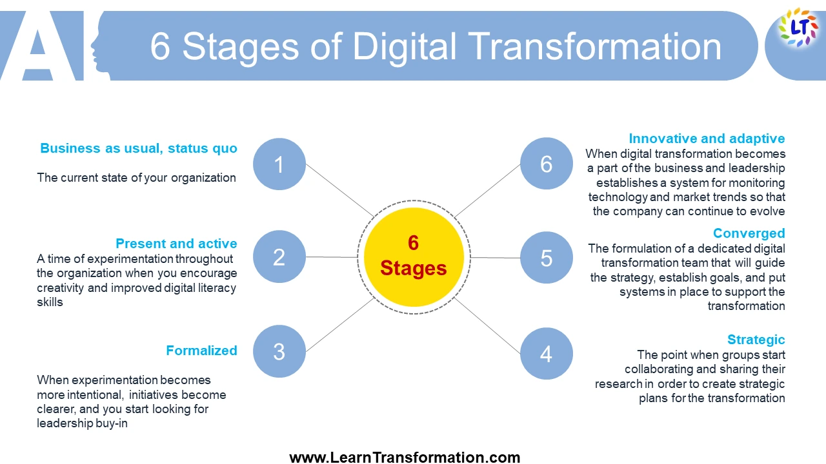

Slide 6
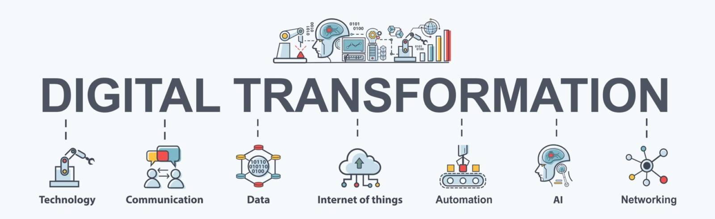
Application domains
Significance of Digital Transformation:
Competitive Advantage: Digital transformation enables organisations to gain a competitive edge by optimising operations, improving customer experiences, and fostering innovation.
Market Relevance: In today's digital age, organisations that fail to adapt risk becoming obsolete as customers increasingly expect seamless digital interactions and experiences.
Business Growth: Digital transformation opens up new opportunities for revenue growth by tapping into emerging markets, expanding product/service offerings, and reaching a broader customer base.
Adaptability: In a rapidly changing business environment, digital transformation allows organisations to respond more effectively to market shifts, regulatory changes, and customer demands.
Future-proofing: By embracing digital transformation, organisations position themselves to better navigate future disruptions and stay ahead of the curve in an ever-evolving digital landscape.

Slide 7
Application domains
Examples of Organisations Embracing Digital Transformation:
Amazon: Transformed the retail industry through its e-commerce platform, data-driven recommendations, and innovations such as Amazon Go stores and Prime membership.
Netflix: Disrupted the entertainment industry with its streaming service, personalised content recommendations, and original programming, fundamentally changing how people consume media.
Airbnb: Revolutionised the hospitality industry by creating a platform for peer-to-peer accommodation rentals, leveraging digital technology to connect travellers with hosts worldwide.
Tesla: Transformed the automotive industry by pioneering electric vehicles (EVs), autonomous driving technology, and over-the-air software updates, redefining the concept of a car as a connected device.
Alibaba: Transformed e-commerce in China and beyond with its digital marketplace, online payment platform (Alipay), cloud computing services, and ecosystem of digital services.
Zoom: Transformed the way people communicate and collaborate with its video conferencing platform, experiencing explosive growth during the COVID-19 pandemic and becoming synonymous with remote work and virtual meetings.
South Africa?

Slide 8
Case Study: Digital Transformation at a Brick-and-Mortar Retailer
Background:
A traditional brick-and-mortar retailer faced challenges competing with online e-commerce giants and meeting changing customer expectations.
To remain competitive and enhance the customer experience, the retailer embarked on a digital transformation journey.
Digital Transformation Initiative:
Omnichannel Strategy: The retailer implemented an omnichannel approach, integrating its physical stores with online channels to provide a seamless shopping experience across multiple touchpoints.
Digital Payment Solutions: Introduced digital payment options such as mobile wallets and contactless payments to offer customers more convenience and flexibility at checkout.
Personalised Marketing: Leveraged data analytics and customer insights to deliver personalised marketing campaigns, product recommendations, and promotions tailored to individual preferences.
In-Store Technology: Deployed interactive kiosks, digital signage, and augmented reality (AR) experiences in-store to engage customers and enhance their shopping experience.
What is the impact of this digital transformation?

Slide 9
Case Study: Digital Transformation at a Brick-and-Mortar Retailer
Impact:
Increased Customer Engagement: The omnichannel approach allowed customers to research products online, make purchases in-store or online, and access personalised recommendations across channels.
Improved Inventory Management: Real-time inventory visibility enabled better inventory management and fulfilment, reducing out-of-stock situations and improving order accuracy.
Enhanced Customer Loyalty: Personalised offers and rewards incentivised repeat purchases and fostered customer loyalty.
Competitive Advantage: By embracing digital transformation, the retailer differentiated itself from competitors and positioned itself for long-term success in a rapidly evolving retail landscape.

Slide 10
Case Study: Digital Transformation at a Brick-and-Mortar Retailer
Background:
A traditional brick-and-mortar retailer faced challenges competing with online e-commerce giants and meeting changing customer expectations.
To remain competitive and enhance the customer experience, the retailer embarked on a digital transformation journey.
Digital Transformation Initiative:
Omnichannel Strategy: The retailer implemented an omnichannel approach, integrating its physical stores with online channels to provide a seamless shopping experience across multiple touchpoints.
Digital Payment Solutions: Introduced digital payment options such as mobile wallets and contactless payments to offer customers more convenience and flexibility at checkout.
Personalised Marketing: Leveraged data analytics and customer insights to deliver personalised marketing campaigns, product recommendations, and promotions tailored to individual preferences.
In-Store Technology: Deployed interactive kiosks, digital signage, and augmented reality (AR) experiences in-store to engage customers and enhance their shopping experience.
What are the challenges of this digital transformation?

Slide 11
Case Study: Digital Transformation at a Brick-and-Mortar Retailer
Challenges:
Legacy Systems Integration: Integrating digital technologies with existing legacy systems and infrastructure required significant investment and effort.
Data Privacy Concerns: Collecting and utilising customer data for personalisation raised concerns about data privacy and security, requiring robust data governance practices.
Change Management: Adopting digital technologies required cultural and organisational changes, including employee training and buy-in from stakeholders at all levels.

